Slide 1
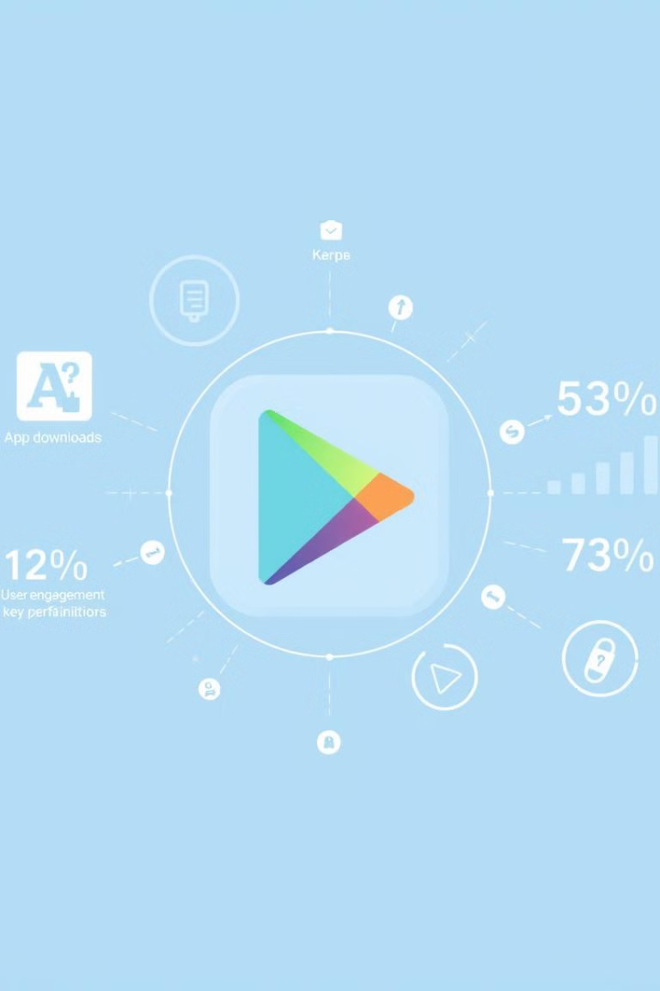
Google Play Store App Success Prediction & Analysis
MGMT 59000-147
Kaushalya Naidu
Navya Kondaveeti

Slide 2
Dataset Overview
Source & Composition
Data Challenges
The dataset is sourced from Kaggle, comprising over 2.3 million apps. Key features include ratings, installs, category, price, ad support, in-app purchases, app success metrics (reviews, installs, user engagement), and app removal status.
Challenges include missing values in rating, installs, and price. Categorical features like category and content rating require encoding to be used in machine learning models.

Slide 3
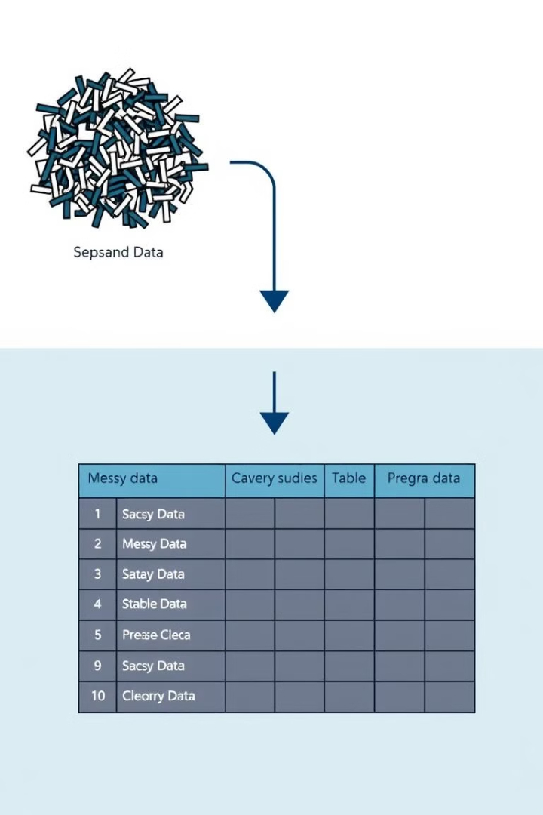
Data Preprocessing & Cleaning
1
Data Exploration
In-depth exploratory data analysis (EDA) to understand key trends in app success, removal risk, and user churn.
2
Handling Missing Values
Missing ratings were imputed with the average rating. Missing prices were replaced with 0, assuming free apps are the default.
3
Feature Engineering
Installs and price were converted to numeric values.

Slide 4
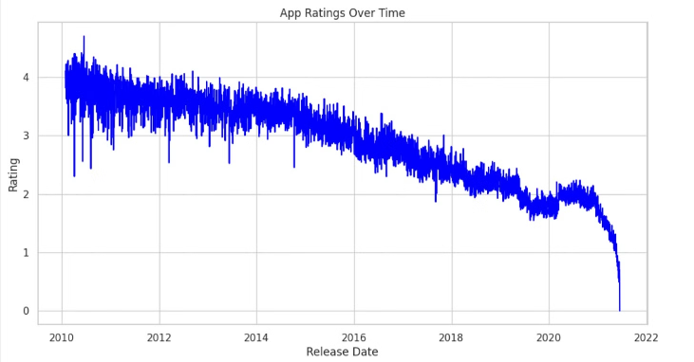
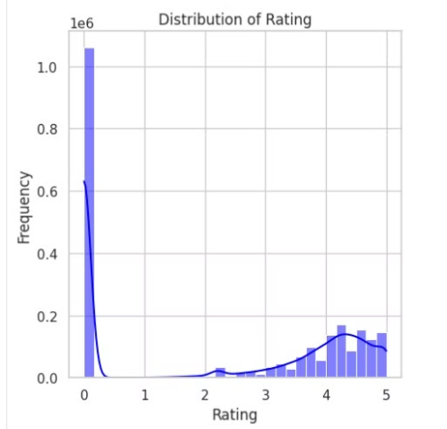
Exploratory Data Analysis (EDA)
App Rating Analysis
Success Rate by Category
This showed a downward trend in app ratings on the Google Play Store from 2010 to 2022, indicating a general decrease in user satisfaction or changes in rating behaviors over the years
Social, finance, and productivity apps have the highest success rates. Educational and utility apps struggle with lower engagement.

Slide 5
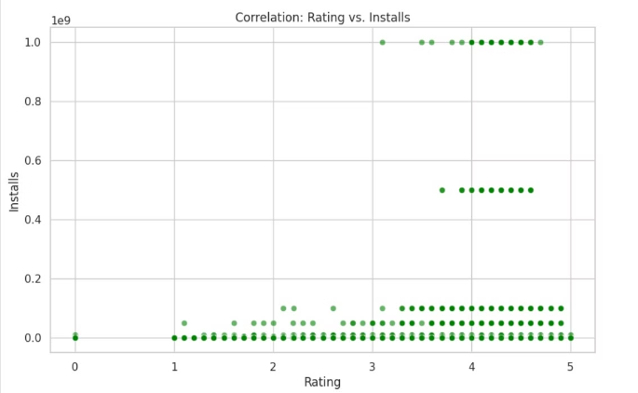
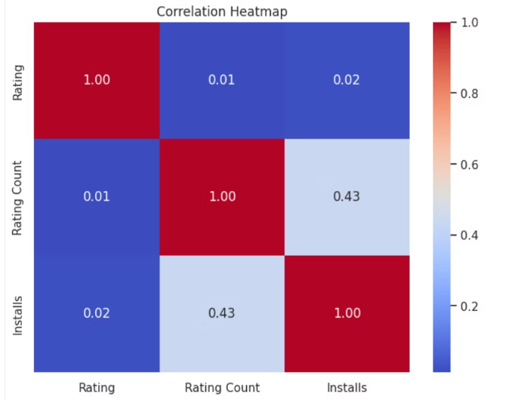
Exploratory Data Analysis (EDA)
App Removal Risk
Correlation Insights
Low-rated apps (under 3.0) face a higher removal risk. Finance and gaming categories see frequent removals due to policy violations.
Rating and installs show a strong positive correlation. Ad-supported apps tend to have higher churn rates. Price has a negative correlation with installs.

Slide 6
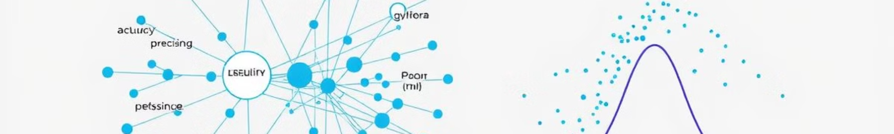
Machine Learning Models & Performance
Churn Prediction
1
A random forest model predicts app churn based on ratings, installs, ad support, and category index. Low-rated apps and ad-supported apps experience higher churn rates.
2
Impact of Pricing & In-App Purchases
A logistic regression model predicts app success with an AUC score of approximately 0.966, indicating excellent accuracy in distinguishing between successful and unsuccessful apps.
App Categorization
3
Utilizing K-Means clustering, we grouped apps into distinct categories based on user engagement metrics. This enables targeted marketing and development strategies by identifying distinct user engagement patterns.

Slide 7
Our Models
Model: RandomForest Classifier
Model: Logistic Regression
Model: K-Means Clustering
Business Problem: Develop predictive models to classify apps on the Google Play Store based on their likelihood of being successful, removed, or experiencing user churn.
Business Problem: Predict the likelihood of app success in the Google Play Store based on characteristics such as ratings, price, and user engagement metrics using supervised learning to guide development and marketing strategies.
Business Problem: Group apps into distinct categories based on user engagement metrics using unsupervised learning to optimize app development and marketing strategies.
Evaluation Metrics: Success Prediction Accuracy,Removed Prediction Accuracy,Churn Prediction Accuracy
Evaluation Metrics: Within-cluster sum of squares (WCSS), Silhouette Score
Evaluation Metrics: Area Under the ROC Curve (AUC), Precision
Output:
Output:
Output:
Training model with k = 6 WCSS: 3418245.624669185 Silhouette Score: 0.6543460193152211
Success Prediction Accuracy: 0.9726322981259027 Removed Prediction Accuracy: 0.9785153378477718 Churn Prediction Accuracy: 0.9698864471715573
AUC: 0.969480653931378 Best Regularization Parameter: 0.01 Best ElasticNet Parameter: 0.5
Best k: 6 with WCSS: 3418245.624669185

Slide 8

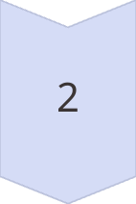
Business Insights & Recommendations
For Developers
Developers should focus on enhancing user experience and adding features that align with the high-engagement clusters to boost app success rates.
Marketing Strategies
Marketing strategies should be customized to target the specific needs and preferences of each user segment identified through clustering.

Slide 9


Conclusion & Future Work
Summary of Findings
Apps with high user engagement metrics tend to form distinct clusters, which can be targeted with specific development and marketing strategies. Low-rated apps face a higher risk of removal. Certain categories have higher churn and removal risks.
Next Steps
Deploy model for real-time app success prediction, improve churn prediction using user session data, and expand analysis to monetization strategies and revenue prediction.
1
2

Slide 10
References
Data Source
Machine Learning
Kaggle
Machine learning models implemented using Spark ML
Data Visualization & EDA
Data visualization & EDA performed using Matplotlib, Seaborn, and Pandas
This report provides a comprehensive overview of the project, detailing data insights, model performance, and actionable recommendations for developers and Play Store policymakers.

Slide 11
Thank You!

